Slide 1
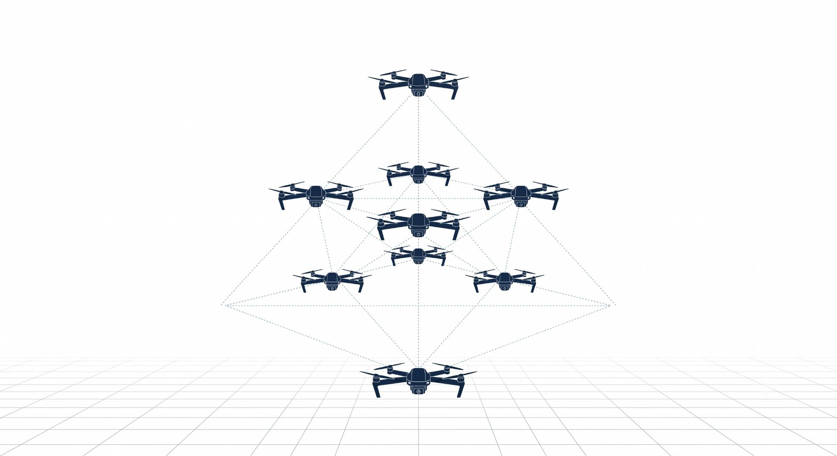

Multi-Agent Proximal Policy Optimization for Joint Dynamic Target Assignment and Collision Avoidance in UAV Systems
Ayesha Khalil, CIIT/SP25-RCS-009/ATD
Supervisor: Dr. Faisal Rehman Co-supervisor: Mr. Ehzaz Mustafa

Slide 2
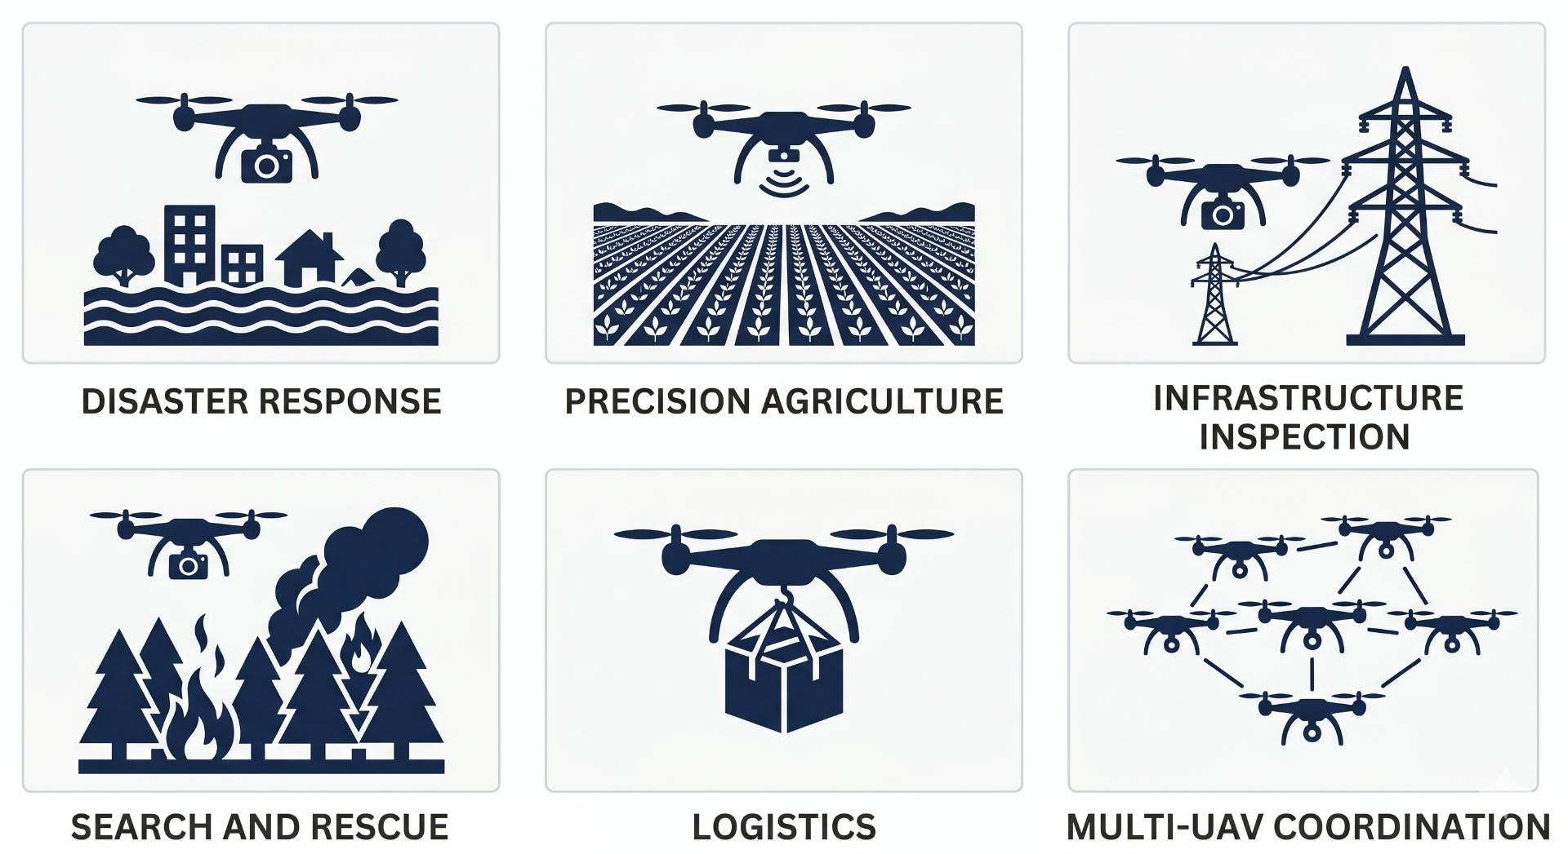
Introduction: Why UAVs?
From military tools to critical civilian infrastructure
UAVs are frequently used in disaster response, agriculture and inspection.
Single drone cannot cover complex and large-scale missions.
Teams of drones are faster, redundant and more effective.
Hardware is ready, coordination is the unsolved problem.

Slide 3
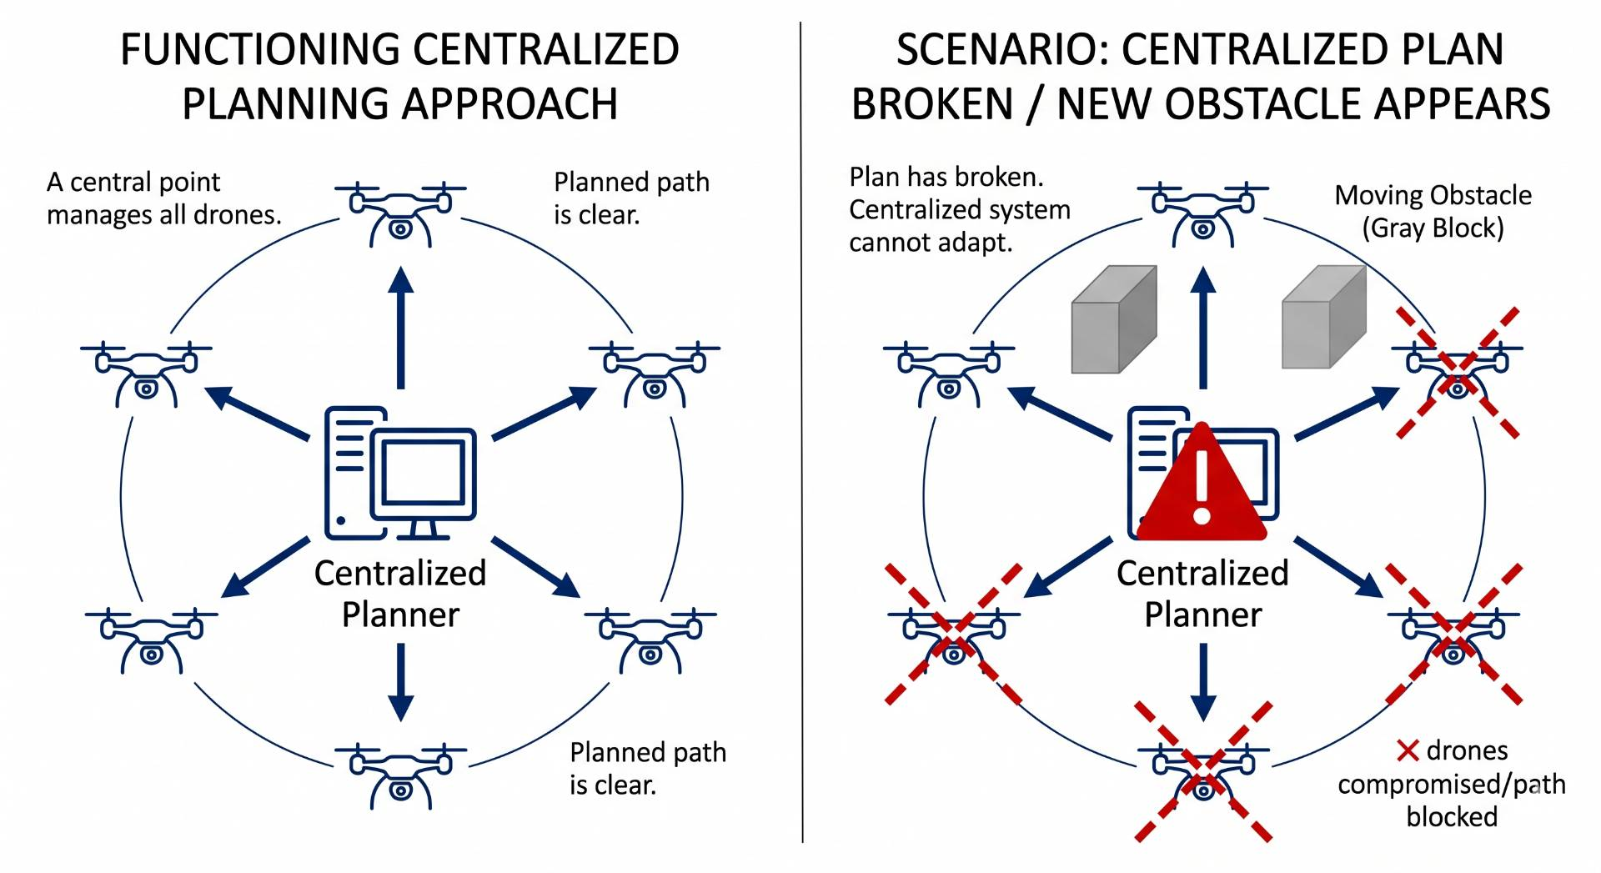
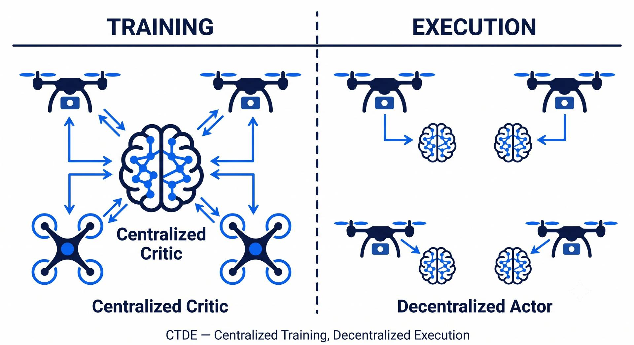
Introduction: Multi-UAV Coordination
Multi-UAV Coordination & Learning
Classical planners fail in dynamic environments.
Drones must learn coordination through experience.
DRL: agent receives reward and learns optimal policy.
MARL: extends DRL to group of cooperating agents.
CTDE: train with shared info, execute independently.

Slide 4
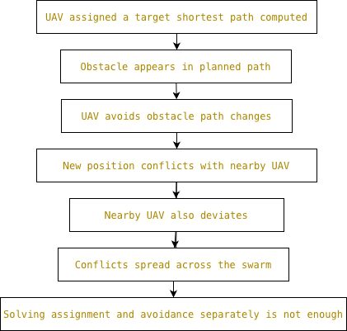
Motivation:
Why Joint Optimization?
One obstacle, swarm-wide conflict.
Assignment and avoidance are coupled.
Separate solutions are not enough.

Slide 5
Related Work:
.
Author | Method | Single / Multi-UAV | Dynamic Obstacles | Target Assignment | Collision Avoidance | Path Optimization | Weights
Tang et al. [1] | Improved D3QN with PER | Single | ✓ | ✗ | ✗ | ✓ | Fixed
Kong et al. [2] | TANet-TD3 | Multi-UAV | ✓ | ✓ | ✗ | ✓ | Fixed
Jarray et al. [3] | Dynamic Reward DQN | Single | ✓ | ✗ | ✗ | ✓ | Dynamic
Zhang et al. [4] | Mean-Field DDPG | Multi-UAV | ✗ | ✗ | ✗ | ✓ | Fixed
Poudel & Moh [5] | MAML-MARL | Multi-UAV | ✓ | ✗ | ✗ | ✗ | Fixed
Rezaee et al. [6] | IGAT-MARL | Multi-UAV | ✓ | ✗ | ✓ | ✗ | Fixed
Sheng et al. [7] | DA-MAPPO | Multi-UAV | ✗ | ✓ | ✗ | ✓ | Fixed

Slide 6
Gap in existing work:
Target assignment and collision avoidance are structurally coupled.
Any path change changes whether the target remains reachable.
No single learned policy addresses both objectives together.
No mechanism dynamically prioritizes between the two in real time.

Slide 7
Problem Statement:
In multi-UAV systems, efficient task servicing depends on both accurate target assignment and safe UAV navigation. When target assignment and collision avoidance are optimized independently, UAVs may be directed toward conflicting service locations, resulting in trajectory overlaps, increased maneuvering delays and inefficient resource utilization. Excessive collision avoidance actions can force UAVs to deviate from their assigned targets, causing prolonged service times, task deadline violations, and reduced performance.

Slide 8
Research Objective
Design a learned mechanism to balance assignment and avoidance jointly.
Evaluate framework performance across varying swarm sizes and obstacle densities.
Compare learned α against fixed reward weights.

Slide 9
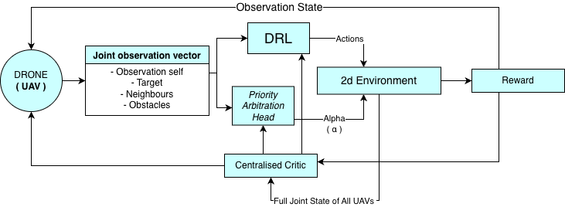
Proposed Methodology:
.

Slide 10
References:
[1] J. Tang, Y. Liang, and K. Li, "Dynamic scene path planning of UAVs based on deep reinforcement learning," Drones, vol. 8, no. 2, p. 60, 2024.
[2] X. Kong, Y. Zhou, Z. Li, and S. Wang, "Multi-UAV simultaneous target assignment and path planning based on deep reinforcement learning in dynamic multiple obstacles environments," Front. Neurorobot., vol. 17, p. 1302898, 2024.
[3] R. Jarray, I. Zaghbani, and S. Bouallègue, "Dynamic reward-based deep reinforcement learning algorithm for UAV path planning in large-scale environments," Procedia Comput. Sci., vol. 270, pp. 692-702, 2025.
[4] Y. Zhang et al., "Large-scale UAV swarm path planning based on mean-field reinforcement learning," Chin. J. Aeronaut., vol. 38, no. 9, p. 103484, 2025.
[5] S. Poudel and S. Moh, "MAML-integrated multi-agent reinforcement learning for adaptive coalition-based UAV coordination in disaster scenarios," Internet of Things, vol. 37, p. 101930, 2026.
[6] M. R. Rezaee et al., "Efficient multi-agent deep reinforcement learning algorithm for multi-UAV collision avoidance," Appl. Soft Comput., vol. 197, p. 115145, 2026.
[7] Y. Sheng, X. Xie, H. Liu, and J. Li, "Dynamic target assignment and cooperative decision-making for UAV swarms based on multi-agent reinforcement learning," IEEE Internet Things J., doi: 10.1109/JIOT.2026.3686066, 2026.

Slide 11
Thank you!

